Slide 1
GLOBAL NEXT CONSULTING INDIA PRIVATE LIMITED
2039
MINI PROJECT REPORT
SUMMER INTERNSHIP PROGRAM IN AI & ML
TOPIC: Credit Card Fraud Detection EDA
(WEEK2)
Presented By: BETHA JAYANTH VEER
Date : 15-06-2026

Slide 2
PROJECT OVERVIEW
Project Title: Credit Card Fraud Detection EDA.
Domain: IT Security.
Problem Statement: Credit card fraud has become a major concern in digital transactions. Analyzing transaction data can help identify patterns associated with fraudulent activities and provide insights into transaction behavior.
Dataset Used: Kaggle Credit Card Fraud Dataset.
Project Overview:
Analyze fraud and non-fraud transactions.
Study transaction amount patterns.
Analyze merchant categories.
Examine foreign and domestic transactions.
Identify key trends using visualizations.
Generate meaningful insights from transaction data.

Slide 3
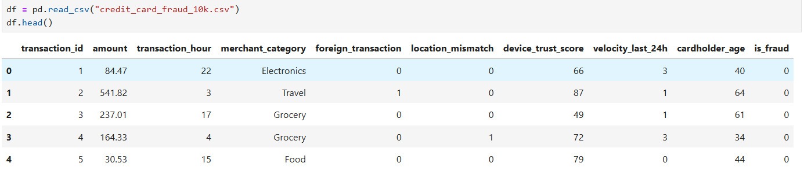
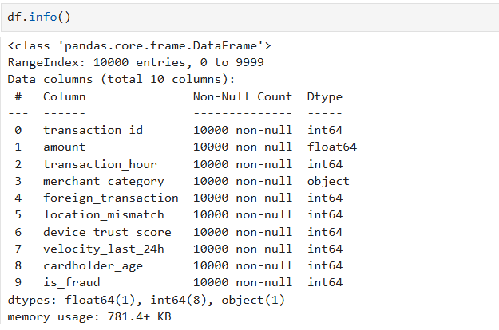
DATASET DESCRIPTION
The dataset contains information about credit card transactions and fraud-related attributes.

Slide 4
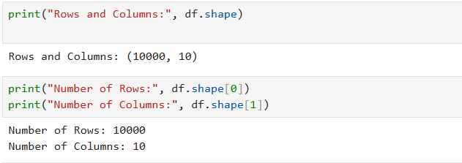
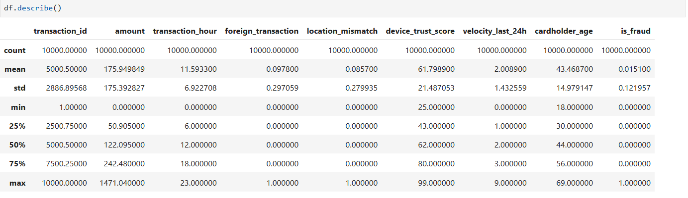
DATASET DESCRIPTION
The dataset contains information about credit card transactions and fraud-related attributes.

Slide 5
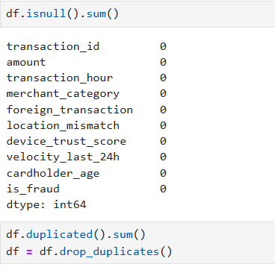
DATASET PREPROCESSING
We perform data preprocesing to prepare the datsset for analysis.. we check whether the data set contains null or duplicate values.

Slide 6
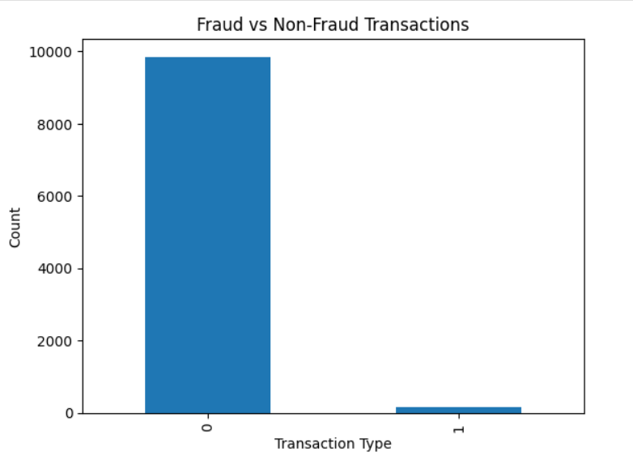
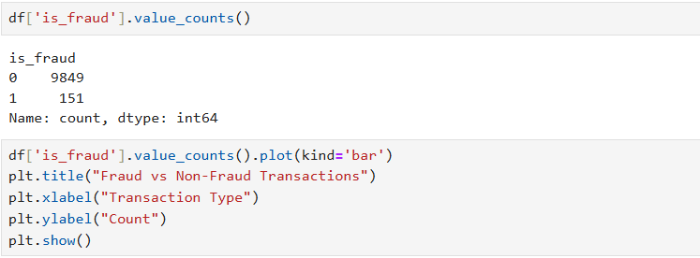
FRAUD VS NON-FRAUD ANALYSIS
The dataset was analyzed to compare fraudulent and genuine transactions.
Transaction counts were calculated for each class.
A bar chart was used to visualize the distribution.

Slide 7
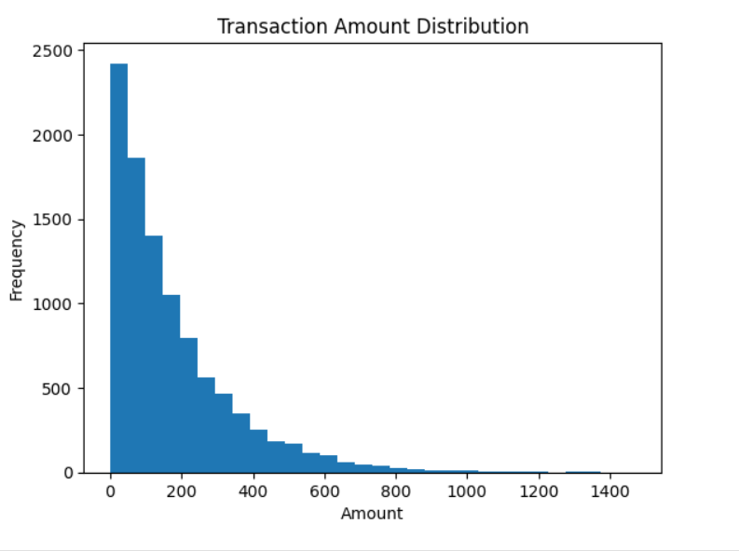
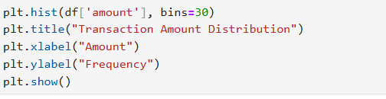
TRANSACTION AMOUNT ANALYSIS
Transaction amounts were analyzed to understand spending patterns.
A histogram was created to visualize the distribution of transaction values.
This helps identify common transaction ranges.

Slide 8
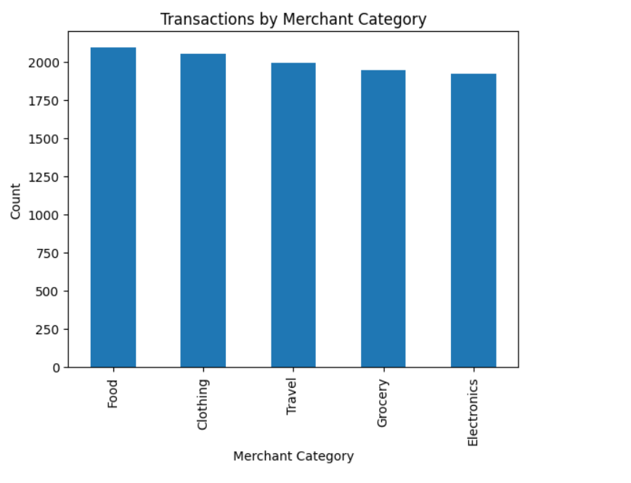
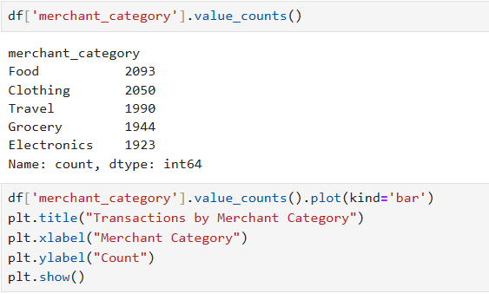
MERCHANT CATEGORY ANALYSIS
Transactions were grouped based on merchant categories.
The frequency of transactions in each category was calculated.
A bar chart was used to compare merchant categories .

Slide 9
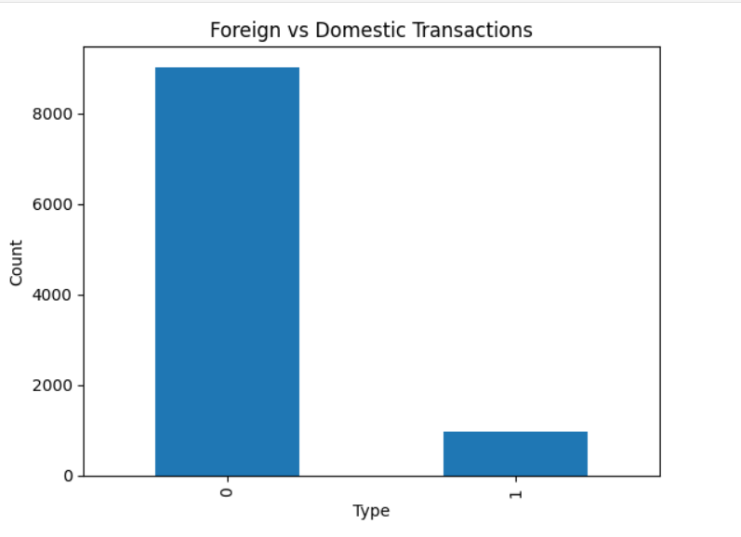
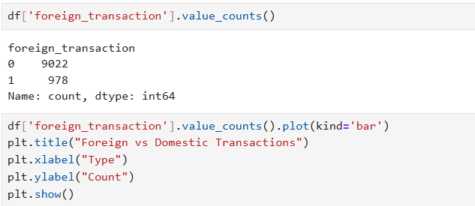
FOREIGN TRANSACTION ANALYSIS
Transactions were analyzed based on whether they were foreign or domestic.
The distribution was visualized using a bar chart.
This helps understand transaction patterns across locations.

Slide 10
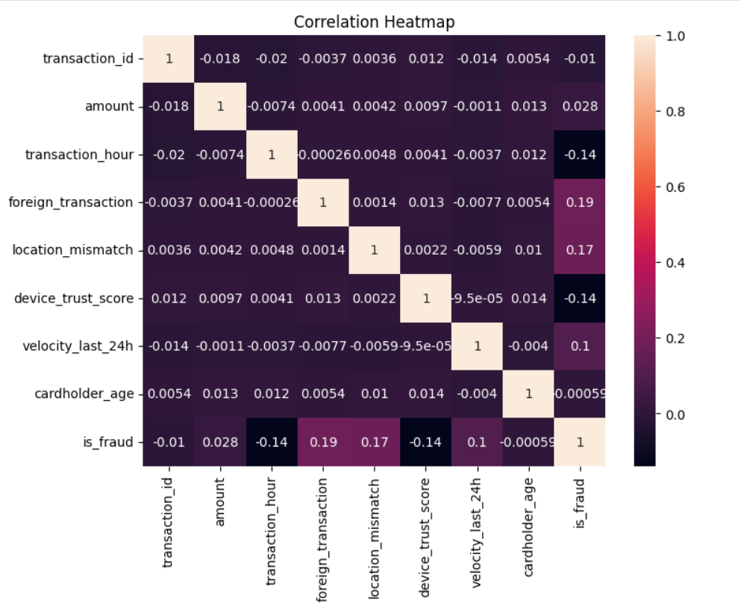
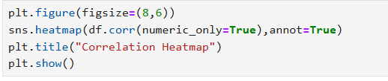
CORRELATION HEATMAP
A correlation heatmap was generated to identify relationships among numerical variables.
Correlation values range from -1 to +1.
The heatmap helps understand how different transaction features are related.

Slide 11
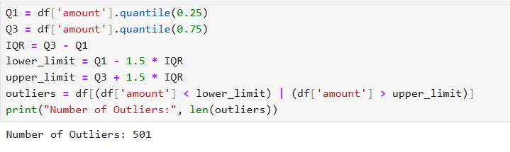
OUTLIER DETECTION
Outliers were detected using the IQR method.
Extreme transaction amounts were identified.
Outlier detection helps in recognizing unusual transaction behavior.

Slide 12
CONCLUSION
In this project, I analyzed a credit card fraud dataset using Exploratory Data Analysis (EDA) techniques. The dataset was first cleaned by checking for missing values and duplicate records to ensure accurate analysis. Different visualizations were created to understand transaction patterns, merchant categories, foreign transactions, and cardholder details.
Outlier detection was performed to identify unusual transaction amounts, while pattern recognition helped compare fraudulent and non-fraudulent transactions. Through this analysis, I gained a better understanding of how transaction data can be used to identify suspicious activities and detect potential fraud. Overall, this project improved my practical knowledge of Python, data analysis, and data visualization techniques.

Slide 13
THANK YOU

